Slide 1

C++ Development with
Rong Lu
Principal Program Manager
Visual C++, Microsoft
(@davorabbit, @visualc)

Slide 2

Win an Xbox One S Forza Horizon 3 + Destiny 2 Bundle!
Take this survey:
https://aka.ms/cppcon

Slide 3
This is NOT the talk on MSVC and VS2017
Microsoft Visual C++ (MSVC) Compiler and Libraries
Conformance
Compiler Diagnostics
Code Analysis
Code Gen Quality
Build Throughput
Visual Studio 2017
Faster installation and your disk will thank you
Pain-free upgrade
Just point Visual Studio to your code
Use Visual Studio for all your projects and target platforms
Be more productive than ever

Slide 4
Agenda
Introduction to Visual Studio Code
Demos
20 min challenge: build a “Calculator” from scratch
IntelliSense, Build, Debug…let’s try a more complex C++ program
Make VS Code your editor
Summary
Notes:
How many have heard of VS Code?
How many have used VS Code? with C++ extension?
How many use VS Code on a daily basis?

Slide 5


Lightweight but powerful code editor.
Free. Open source. Runs everywhere.
Built-in support for JavaScript, TypeScript and Node.js.
Support many other languages via extensions.
C++, C#, Python, PHP, Go…
Extensible and customizable.
Git integration.
https://code.visualstudio.com/

Slide 6
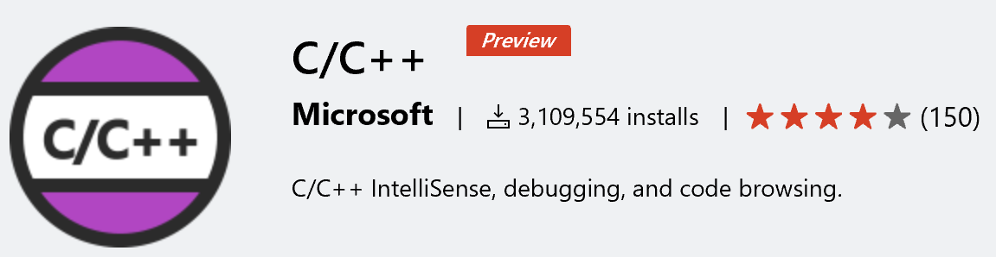
Microsoft C/C++ extension for VS Code
Enables C/C++ IntelliSense, code browsing, code formatting, and debugging.
Over 3 million downloads since first shipped in Mar 2016.
Install: https://aka.ms/vscodecpptools

Slide 7
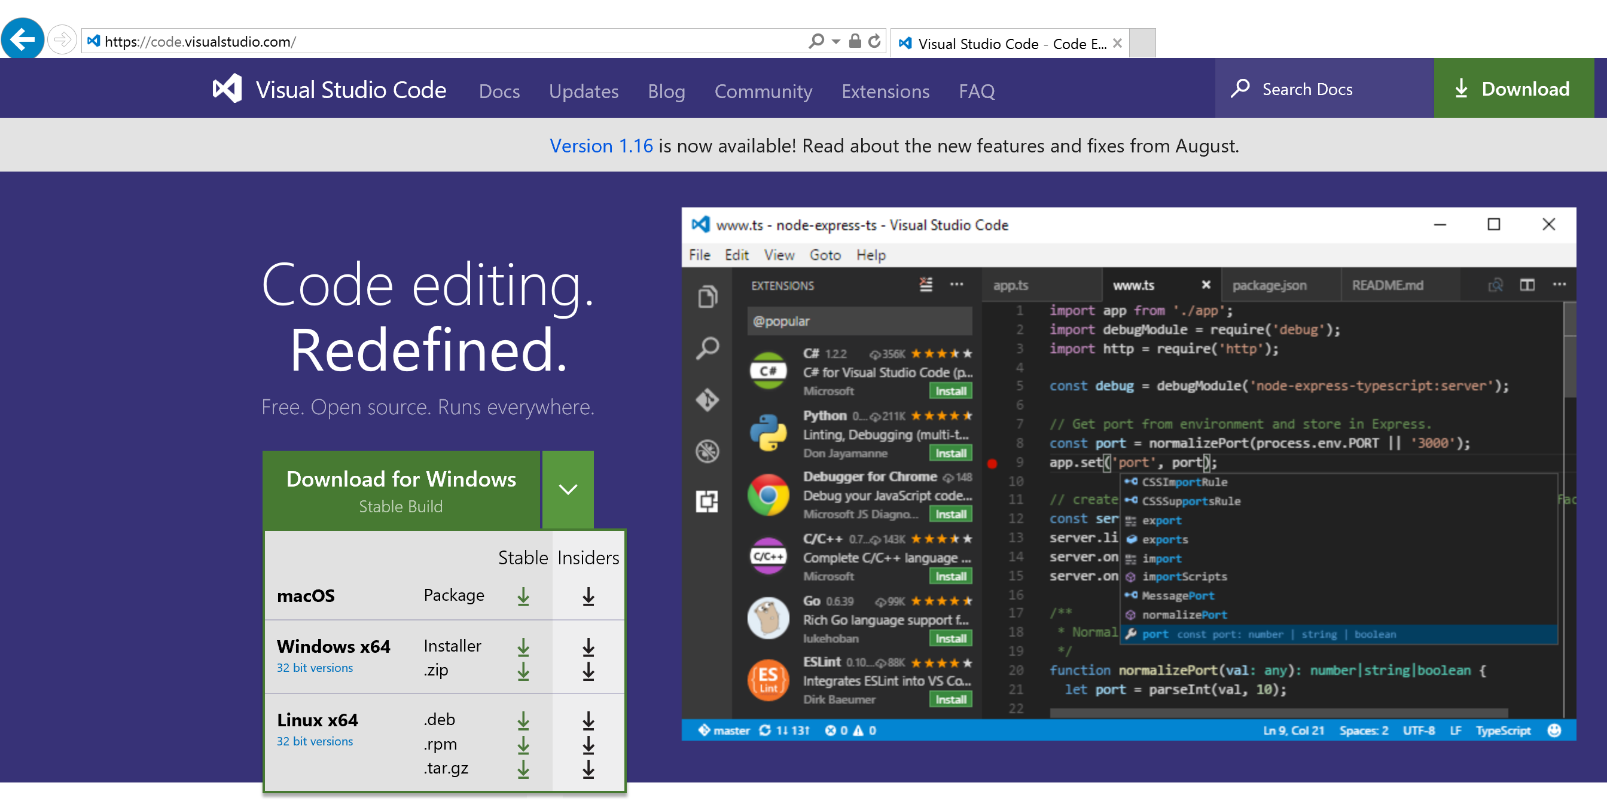
Install VS Code and the C/C++ extension

Slide 8
20 min challenge
Write a ”Calculator” from scratch, build, and debug
Notes:
Features:
Basic intellisense (member list, reference highlighting, parameter hints)
Code formatting
Build (gcc).
Debug with gdb (breakpoint, step). Single configuration with preLaunchTask.
Publish to git

Slide 9
One more thing…
Git integration

Slide 10
Try a more complex program…
IntelliSense. Build. Debug.
Notes:
Intellisense (config includepaths.)
Quick info. Parameter hints. Squiggles.
Multi-line editing
Code browsing (go to def/symbol search/ go to file/line/ switch header source)
Build with gmake
Debugging
launch, attach
Function name breakpoint, conditional breakpoint
Expression evaluation
Multiple threads
GDB command

Slide 11
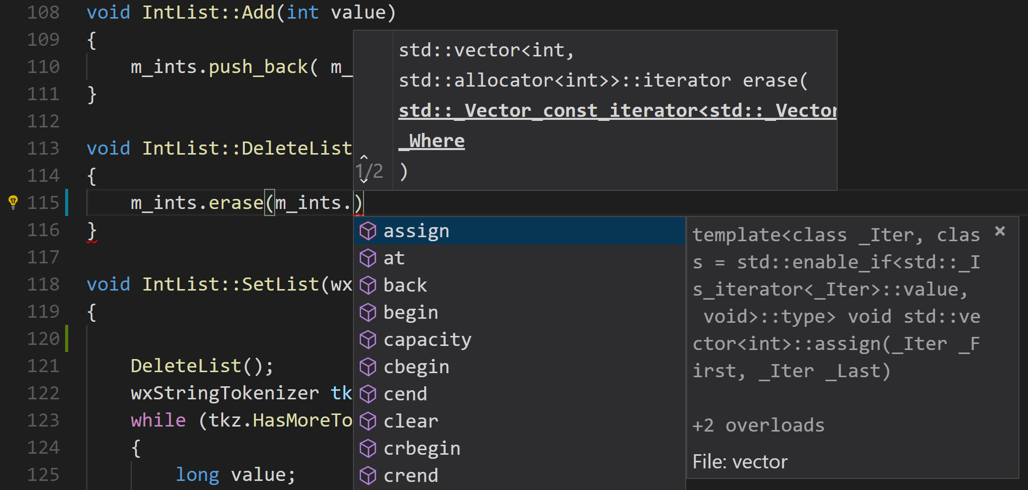
Editing
IntelliSense
Auto complete / Member list
Parameter hints
Quick info tooltip
Reference highlighting
Error squiggles
Code browsing
Go to definition / peek definition
Go to declaration / peek declaration
Go to file / line / symbol
Find / replace
Switch header/source
Code formatting (Clang-format)

Slide 12


How IntelliSense works
IntelliSense results provided by one of two engines:
Compiler-based IntelliSense engine
♥
Tag parser-based IntelliSense engine
"C_Cpp.intelliSenseEngine": "Default“
Uses “includePath” setting. Search is non-recursive.
Same engine as used in Visual Studio
Full semantic knowledge of the source
Accurate results
"C_Cpp.intelliSenseEngine": "Tag Parser“
Uses “browse.path” setting. Search is recursive.
“Token matching” approach
Populate symbol information in a browse database
Fast but “fuzzy” results
Notes:
provides a fast and scalable way to extract information from C++ source code. It is a fuzzy parser, which means that instead of trying to strictly recognize and validate the full C++ syntax (we have an excellent compiler front-end to do that) it lazily matches an input stream of tokens with some patterns. This parser doesn’t populate a symbol table during parsing, it has no notion of types apart from built-in ones, it doesn’t build a full macro context and its unit of translation is a single file (i.e. it doesn’t follow through #include directives). But nevertheless, the parser is able to deal with all of C++, C++/CLI and IDL.

Slide 13
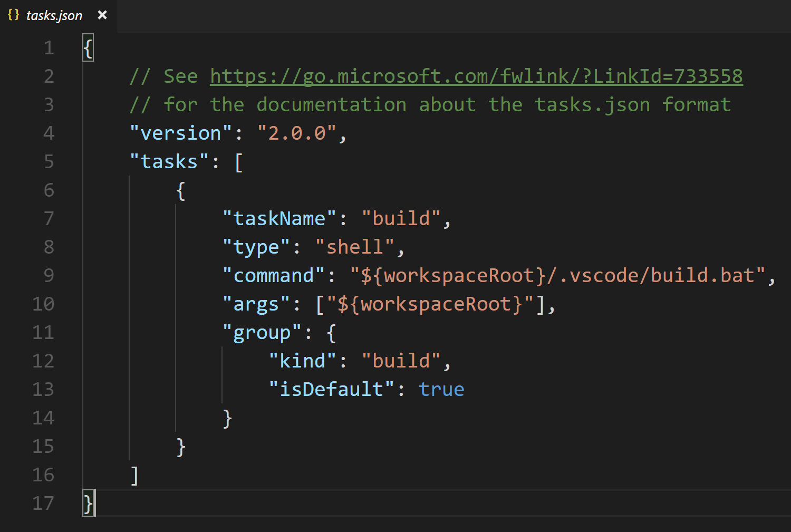
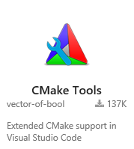
Building
Configure build tasks in the tasks.json file.
Integrate with external tasks
MSBuild, Make, CMake...
Packaging, testing, deploying…
Problem matcher
Integrated Terminal
Cmake Tools extension for VS Code
by vector-of-bool https://marketplace.visualstudio.com/items?itemName=vector-of-bool.cmake-tools

Slide 14
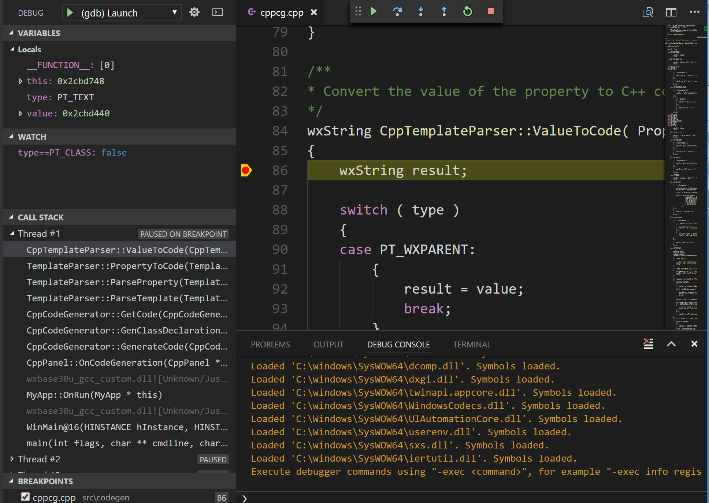
Debugging
Build with symbols for debugging
Breakpoints (function, conditional)
Step Over / Step Into / Run to cursor
Variables / Expression Evaluation
Call stack
Launch / Attach to process
Multi-threaded debugging
Remote debugging
Bash on Windows (WSL) debugging
Execute GDB or LLDB commands in Debug Console
Core dump debugging with GDB

Slide 15
Make VS Code your editor
Notes:
Color themes
Fonts. Settings.
Key bindings
Zen mode

Slide 16
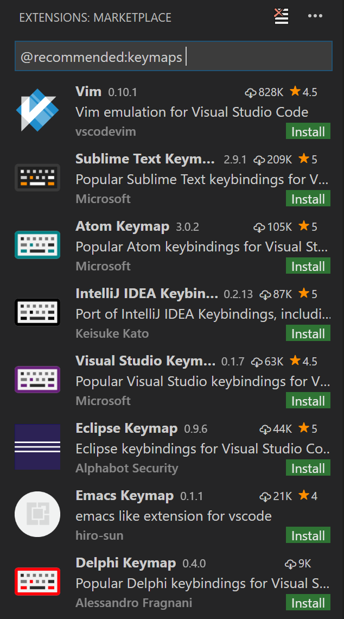
Make VS Code your editor
Color theme
(Ctrl+Shift+P -> Color Theme)
Fonts, and many other settings
(File->Preferences)
Keymap for Vim, Sublime, Atom…
(File->Preferences->Keymap extensions)
Zen mode
(Ctrl+Shift+P->Toggle Zen Mode)

Slide 17
VS Code makes a powerful C/C++ dev environment
Lightweight, Fast
Free, Open source
Runs everywhere
Extensible, Customizable
Git integration
IntelliSense
Code browsing
Code formatting
Build and run external tasks
Debugging

Slide 18


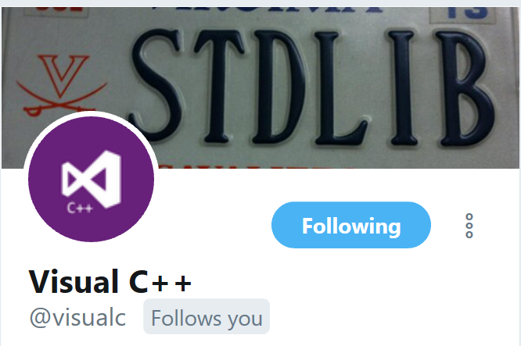

Call to action
(
(
II
Stable build.
Install: https://code.visualstudio.com/
Install: https://code.visualstudio.com/insiders/
&&
&&
https://blogs.msdn.microsoft.com/vcblog/
Install: https://aka.ms/vscodecpptools
Doc: https://code.visualstudio.com/docs/languages/cpp
Feedback: https://aka.ms/vcvscodesurvey
Issues, suggestions: https://github.com/Microsoft/vscode-cpptools/

Slide 19
Q & A
ronglu@microsoft.com

